Slide 1
WP4: WP4 : System Knowledge & Data & Design
Demonstration and mainstreaming of nature-based Solutions for Climate Resilient transformation in the Mediterranean
Risk Profiling task force!!!
Team: 1-CMCC:
29-UNIST-FGAG:

Slide 2
Agenda
Recap WP4 and Task 4.2: DR and RR risk profiles (M01-M36) – 3 mins
Round table introduction, focus on technical skills and contribution – 5 mins
Risk profiling in DR4: Split-Dalmatia County – 20 mins
Metadata collection and Data availability – 5 mins
Storymaps in ArcGIS for DR4 – 15 mins
WebGIS brainstorm – 5 mins
Who do what – 5 mins
Others – 2 mins

Slide 3
Recaps

Slide 4
WP4 : System Knowledge & Data & Design (M1-M58)
M01
M18
M24
M36
M42
M48
M58
CMCC
Deltares
58 months
2024
2025
2026
2027
2028
Deltares
T4.1: M1 - M24
CMCC
4 tasks
T4.2: M1 – M9; M31- M36
DUTH
T4.3: M12 - M42
Deltares
T4.4: M16 – M58
start
end
2 milestones
We are here
M12
M13
DUTH
DUTH
D4.3
DUTH
4 deliverables
D4.1
Deltares
D4.2
CMCC
D4.4
Deltares
19 contributors
1-CMCC; 2-TECNALIA; 4-DUTH; 6-DELTARES; 7-WR; 8-Dyn-V; 10-RAS; 11-SDC; 12-PAP/RAC; 17-REMTH; 17.1-RDF-EMT; 18-CEA; 19-PPT; 23-PAGGAION; 24-EPLO; 26-CRITERIA; 29-UNIST-FGAG; 31-CMMI; 32-Regio SUD
Notes:
Task 4.1: Identifying Key Landscapes’ features (resources, services, link to KCS) (M01-M24) (lead: DELTARES)
Task 4.2: DR and RR risk profiles (M01-M36) (lead: CMCC)
Task 4.3: Data, Mapping & Monitoring (KPI of effectiveness, impact) (M12-M42) (lead: DUTH)
Task 4.4: Balanced portfolio of solutions and pathways (feasible, sustainable, fitting in landscape, use of resources) (M16-M58) (lead: DELTARES)

Slide 5

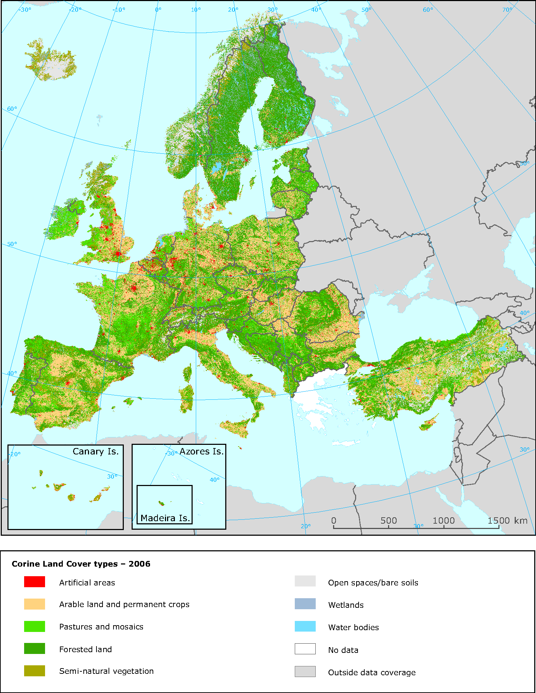
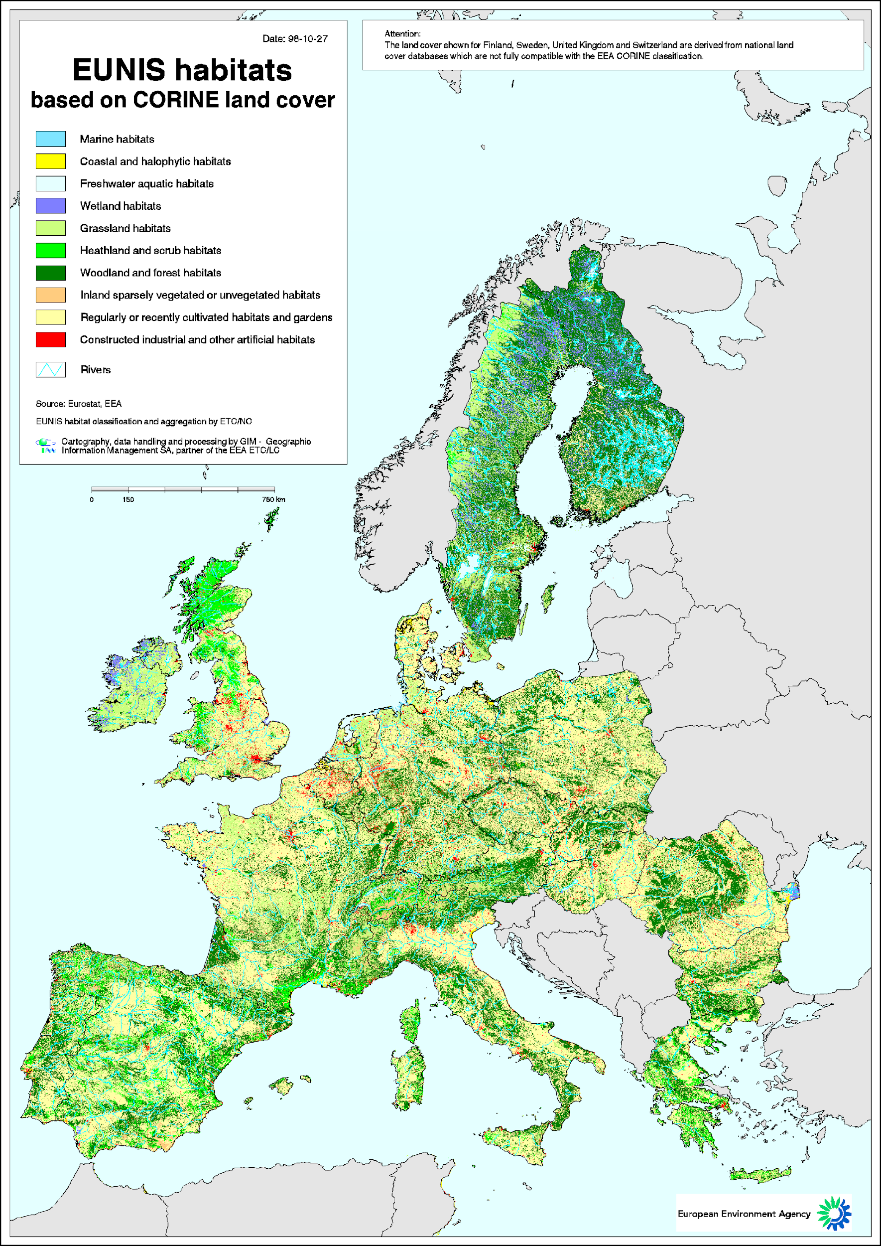
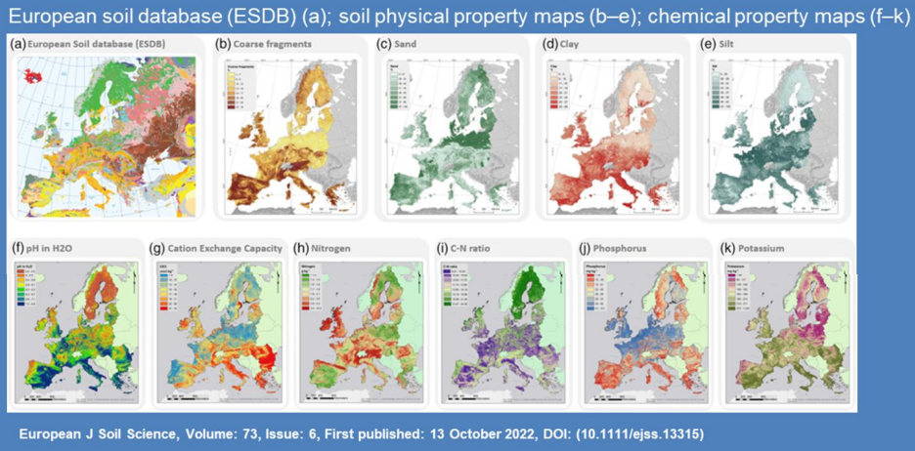
Landscape archetypes
Actions
CORINE land cover
EUNIS habitats
Further classification of Landscape archetypes and subtypes using
physical, social, governance landscape indicators
Determining Scale for Social and Governance Landscape Mapping:
At what geographical scale (city, municipality, region) should we conduct the social and governance landscape mapping to ensure effectiveness and accuracy? NUTS3 level maps?
Collecting Data Sources:
Regions gather and manage data under each specific landscape (sub) archetype to build a comprehensive understanding of physical, social and governance indicators. Who provides data? Meta-data maintenance by WP4 team
Map Landscape Arche(sub)types, use EU/regional databases in the regions > full spatial coverage per region. Which region(s) will elaborate example(s)?
Need more info on social, economic, and governance dimension. Which region(s) will elaborate this in collaboration with WP5 and WP6
Which region(s) will work on this together with WP4 task leads?
EU Soil Database

Slide 6
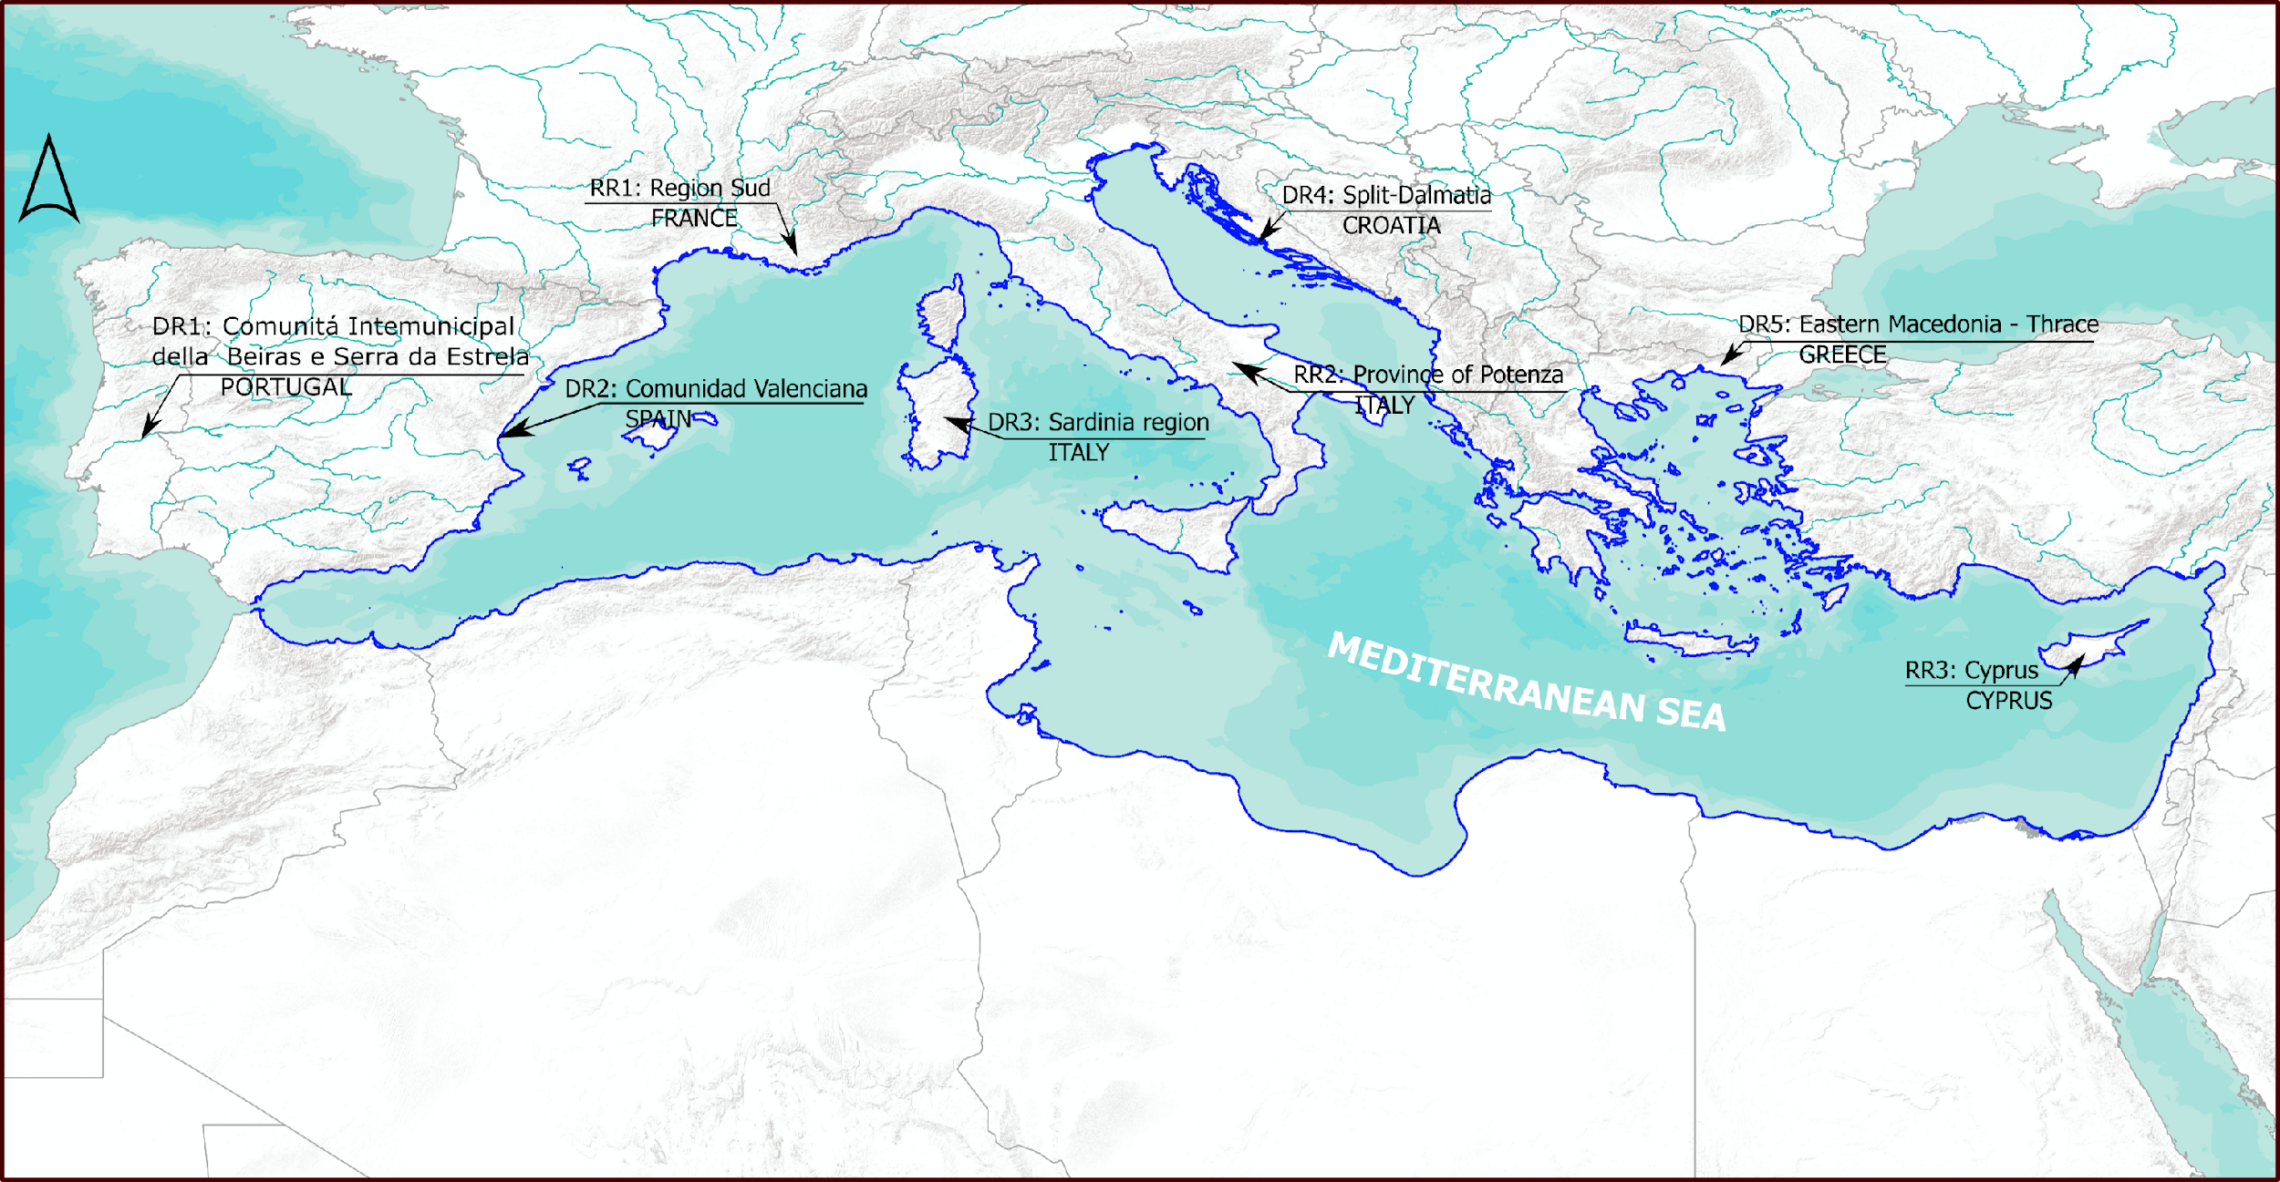

Task T4.2: Risk profiling in DRs
Upscaling vulnerability/risk analysis for the DesirMED project area – on the household level , taking into account socio-economic data
Implementation of the regional high resolution sensory network. Irrigation, water availability, sprinkler towers distribution, sylvicultural treatments...
Integrate hydrodynamic and wave data into the GNN-model for risk assessment of Posidonia.
Working on several case studies and hazard related: Coastal erosion hazards, Flood Protection, Minimize Urban Pollution, Drought risks and hazards
Already discussed
Risk profiling
On the way

Slide 7
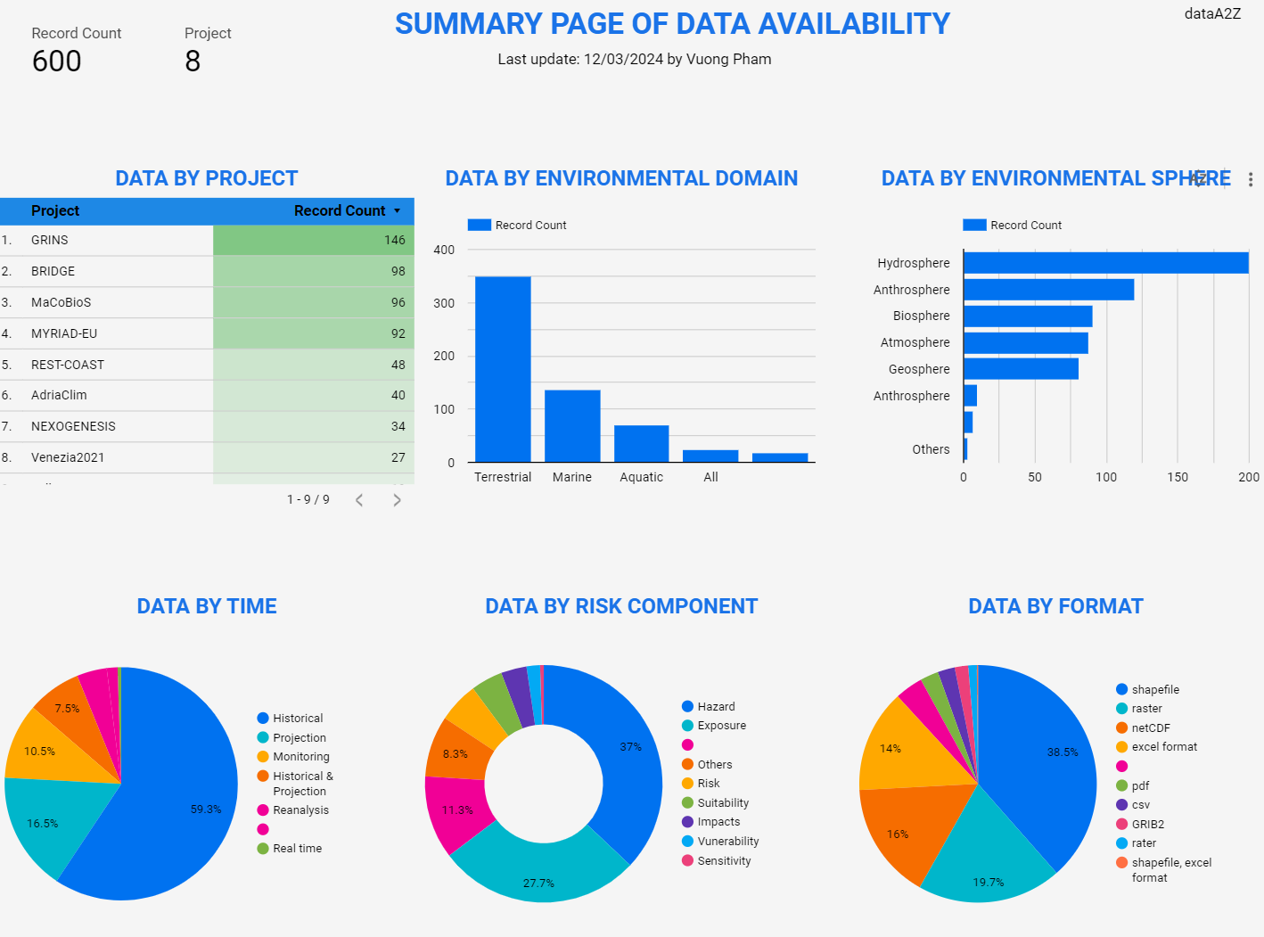
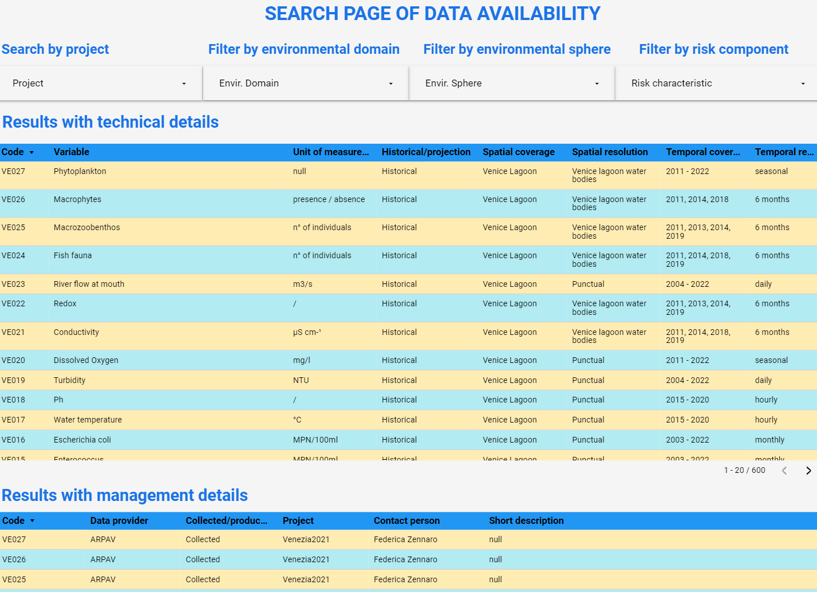
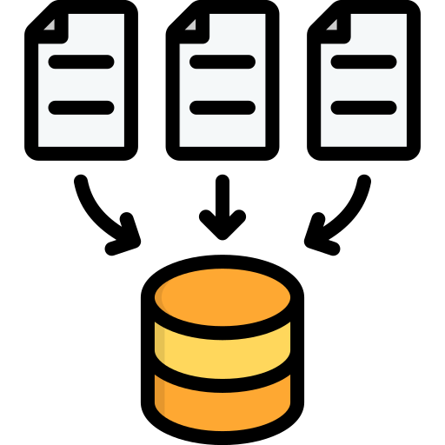
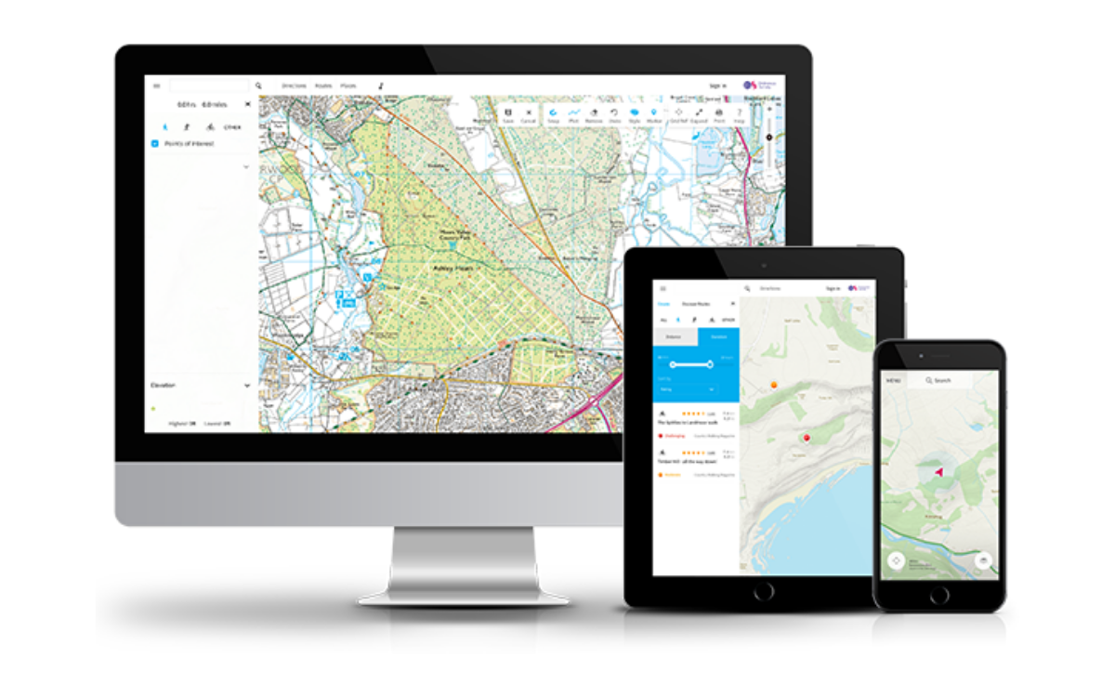
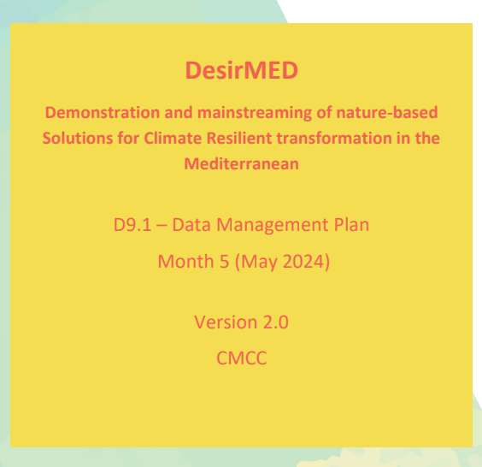
Task 4.2: Risk profiling in DRs
Dashboarding
Data sharing among regions
Web-GIS
Meta data collection
Deliverable 9.1: Data management plan

Slide 8
Our team

Slide 9
Who do what?
Please add info related to tasks underpinning this discussion
Name | Background | Research topics | GIS skills | Programming skill | Others
Vuong Pham | Environmental engineering | Risk assessment, ecosystem services, Data analytics, ML | QGIS (Advanced); ArcGIS, Google Earth, WebGIS (Basic) | R (Advanced); Python, Matlab, GEE (Basic) | Data analytics and dashboarding (lookerstudio, tableau)
Elisa Furlan | Environmental science and planning | Multi-hazard risk modelling, Cumulative impact assessment, adaptation planning | QGIS, ArcGIS |  | RA nested with NBS adaptation planning. What-if scenario analysis and storytelling in co-design environment.
Christian Simeoni | Environmental science | Risk and cumulative impact assessment, ML | QGIS, GEE (basic) | Python
Angelica Bianconi | Computer Science | ML, DL, Risk assessment, Data analytics | QGIS, GEE | Python (Expert); JavaScript, Java, C++, Matlab, R (Intermediate) | ML/DL frameworks (PyTorch, Keras, Tensorflow, sklearn); Big data framework (Apache Spark); cdo (Beginner)
Fabio Favilli | Urban planner | Data analytics, Data visualization, Mapping, Risk assessment | QGIS, Maputnik (style editor for web platform MapLibre) | Python, GEE, JavaScript (basic) | Mapbox (basic), Graph Knowledge management (Logseq / Obsidian)
Martina Baučić | Geoinformatic | Modelling geospatial data and analysis, Semantic interoperability | QGIS, ArcGIS | JavaScript (basic) | Modelling tools (UML modelling, Enterprise Architect, Visio) Graphic tools (AutoCAD, vector and image editing)
Samanta Bačić | Geodesy and Geoinformatic | Land management, land administration, green infrastructure, MCDM | QGIS (Advanced); SAGAGIS (basic) | Matlab, Java (basic) | AutoCAD, Geotrans, PCTrans (Advanced); FreeCAD, MicroStation, Golden Software Surfer, Caris Easy View (intermediate)
Frane Gilić | Geodesy and Geoinformatic | Land cover mapping, DEMs, Remote sensing, Georeferencing data | QGIS (Advanced); PostGIS (Intermediate) | Python/Django (Intermediate); GEE, JavaScript, R (Basic) | CAD, Microsoft Azure (basic), Moodle, LaTeX, Point clouds (PDAL, Potree), Pix4Dmapper

Slide 10
Risk profiling
DR4

Slide 11
Task T4.2: Risk profiling in DRs
Upscaling vulnerability/risk analysis for the DesirMED project area – on the household level , taking into account socio-economic data
Implementation of the regional high resolution sensory network. Irrigation, water availability, sprinkler towers distribution, sylvicultural treatments...
Integrate hydrodynamic and wave data into the GNN-model for risk assessment of Posidonia.
Working on several case studies and hazard related: Coastal erosion hazards, Flood Protection, Minimize Urban Pollution, Drought risks and hazards
Already discussed
Risk profiling
On the way

Slide 12
Task 4.2: Risk profiling in DRs
Main ideas for the Split-Dalmatia County
Upscaling vulnerability/risk analysis for the DesirMED project area – on the household level , taking into account socio-economic data. Update and extent portfolio of NbS solutions, especially in for the stormwater infrastructure in the urban areas.
Existing analysis:
GIS vulnerability (physical, not socio-economic)
GIS analysis of impreviousness of land use areas for topographic basin of the river Jadro
Developed catalogue of typical coastal flooding protection solutions
Participation approach applied
Meetings with
UNIST-FGAG
Show case of Veneto region applications (AdriaClim project’s risk model) and see the potential application to the Split Dalmatia county case studies.
Next: Data collection and exchange

Slide 13
Large scale
vulnerability analysis

Slide 14
Large scale vulnerability analysis
Physical vulnerability – focuses on physical environment (built or natural)
Social vulnerability - focuses on identifying the most vulnerable groups of people and examines social factors and economic assets, such as poverty, access to food and housing, and human and social capital
Vulnerability assessment:
a quantitative approach based on related indicators and indices, or
a qualitative approach based on the perspectives of stakeholders
National or regional level assessments:
identify the most vulnerable areas and help in prioritizing measures (scales in the range of 1:100.000 to 1:25.000).
Large-scale assessments:
for the planning and implementation of adaptation measures at the household level.

Slide 15
Large scale vulnerability analysis
Large scale vulnerability methods – issues
To perform large scale vulnerability analysis, large scale data should be available.
Topographic maps and urban plans in scale 1:5 000 – generalization 🡪 object displacement (during overlaying features, any data generalisation causes wrong interpretations and objects locations should be checked prior their use and relocated if necessary).
Socio-economic data is aggregated to administrative or census units 🡪 needs for spatial disaggregation of data
Free digital data (e.g. elevation models., land cover etc) do not satisfy/satisfy? needs of large scale analysis
3. Assigning vulnerability index in case of large scale analysis brings a problem of non-uniform tessellation by the vulnerability variables.

Slide 16
Large scale vulnerability analysis
Ad 3)… non-uniform tessellation by the vulnerability variables
……..the key parameter values are not homogeneous over all the area covered by the selected spatial unit (e.g. number of inhabitants in census block).
Solution 1: For large-scale assessments, the final vulnerability assessment can be assigned to the regular spatial tessellation units of a small size, e.g., 10 × 10 m.
Solution 2: Large-scale assessments are fine enough to distinguish particular assets and thus another approach could also be used: assigning vulnerability to each object representing affected assets, such as infrastructure objects (roads, utilities) or buildings.
Several studies focused on the identification of affected buildings and the calculation of economic losses because buildings are key assets for people.
Adaption measures, the calculation of damage to physical objects, and socio–economic vulnerability parameters, such as household income and unemployment, are all spatially assigned to the buildings.

Slide 17
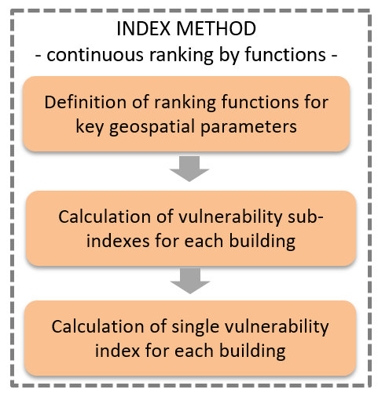

Large scale vulnerability analysis
Example (already done in DR SDC):
Coastal vulnerability analysis for the City of Kaštela
Physical vulnerability elaborated: vulnerability index on house level (hazard: coastal flooding, building sensitivity variables), combination of qualitative and quantitative approach
Small geographic extent - large spatial scale is selected and adopted to the scale of available data (1:5 000)
Index method – combined crisp and continuous ranking
Vulnerability expressed on two levels - detailed level for each asset object (household) and summarized per each asset type
Socio-economic vulnerability – proposed extension/upgrade to be elaborated for the DesirMED with disaggregated socio-econimc data to household level

Slide 18
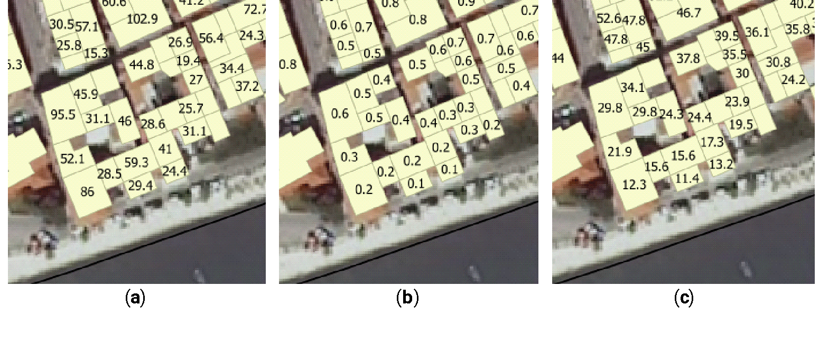
Large scale vulnerability analysis
Physical vulnerability variables for each household/building
Maps showing key geospatial parameters for each building in the study area:
(a) Building footprint area; (b) Elevation above the sea level; (c) Distance to coastline
Socio-economic vulnerability variables for each household/building:
Census data (number of inhabitants, household income……)
Municipality data (use of buildings, interior area, etc – collected by the buildings and floors)
……..

Slide 19
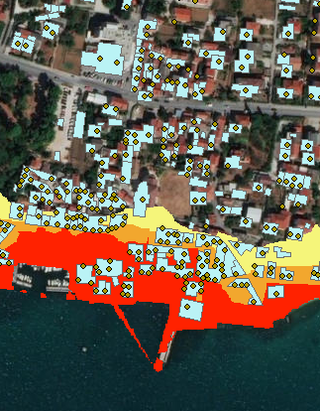
Large scale vulnerability analysis
Socio-economic variables for large scale analysis – main issues
? developed social vulnerability methods – as analytical background for the risk profiling/CCA plans
? define socio-economic data required for the analysis
? identify sources of the required socio-economic data
(e.g. study of data sets included in the European Open Data Initiative)
? propose and test disaggregation techniques to household level
(e.g. number of inhabitants is divided into households depending on the floor plan of the buildings used for permanent residence - additional data sources needed, 3D models of buildings and purpose by the floor; use of official registers etc)

Slide 20
Risk profiling in DR4
Action | Description | Timeline | Lead | Contributors
Data collection | Various data describing natural resources, built environment and socio-economic context (all georeferenced) - open source global data, national and local data | Starting in September 2024 (baseline data). Data will be continuously updated in parallel with the development of risk profiling models. | UNIST-FGAG | CMCC, SDC, PAP/RAC, SUNCE
Conceptual model | Identifying main hazards, assets and their sensitivities, adaptive capacities (including future proposed NbSs) (input from WP1 (visions), WP2 (Nb Solutions portfolio), WP4 T4.1 (key landscape features), WP5 (governance models, legislation framework, stakeholders perspectives). Model will be in large scale / household level enabling detailed risk profiling including socio-economic vulnerability as well as physical vulnerability. | Starting in November 2024 (draft model). Model will be continuously updated in parallel with the development of knowledge from WP1, WP2, T4.1 and WP5. | UNIST-FGAG | CMCC, SDC, PAP/RAC, SUNCE
Baseline model | Encompassing present situation in the region. | Starting in November 2024 (draft model). | UNIST-FGAG | CMCC, SDC, PAP/RAC, SUNCE
Scenario analysis | Envisioning future in the region - based on developed adaptive pathways. |  | UNIST-FGAG | CMCC, SDC, PAP/RAC, SUNCE
Contribution to ArcGIS storymaps for DR4 | Selected elements from the Risk profiling model will be visualized through the texts, pictures, photos and maps - forming story telling maps aiming at powering communication with stakeholders | Starting in September 2024 (draft model end of September - based on baseline data). | UNIST-FGAG | CMCC, SDC, PAP/RAC, SUNCE
Contribution to Web-GIS | Selected elements from the Risk profiling model will be stored as GIS layers and scenarios of adaptive pathways visualized as thematic maps. Up to the previous steps (optionally - now as an idea), Web-GIS could include interactive module for “what-if” scenarios enabling creation of new adaptive pathways based on user input. | Starting in September 2024 (draft model end of September - based on baseline data). | UNIST-FGAG | CMCC, SDC, PAP/RAC, SUNCE

Slide 21
Metadata
&
Data

Slide 22
Task 4.2: Risk profiling in DRs
Dashboarding
Data sharing among regions
Web-GIS
Meta data collection
Deliverable 9.1: Data management plan

Slide 23
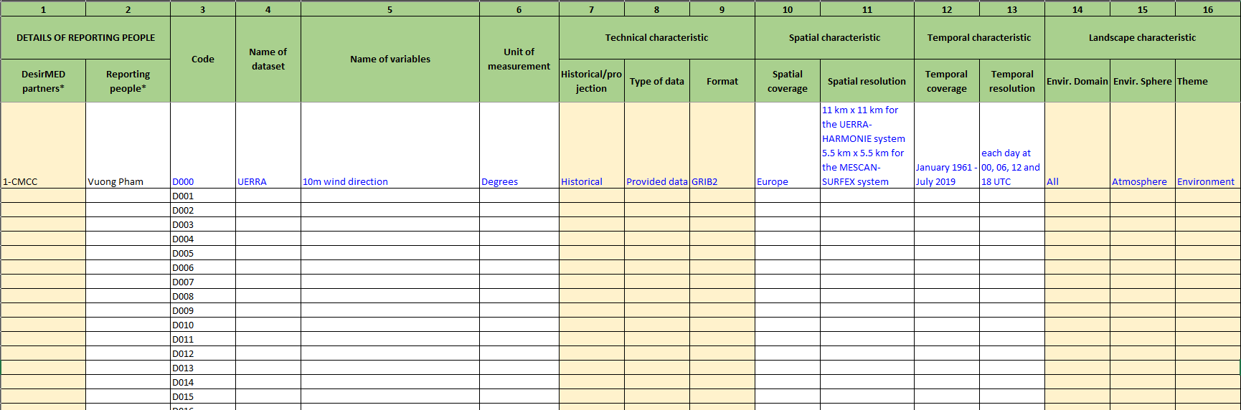
Task 4.2: Risk profiling in DRs
Meta data collection form: any feedback?

Slide 24
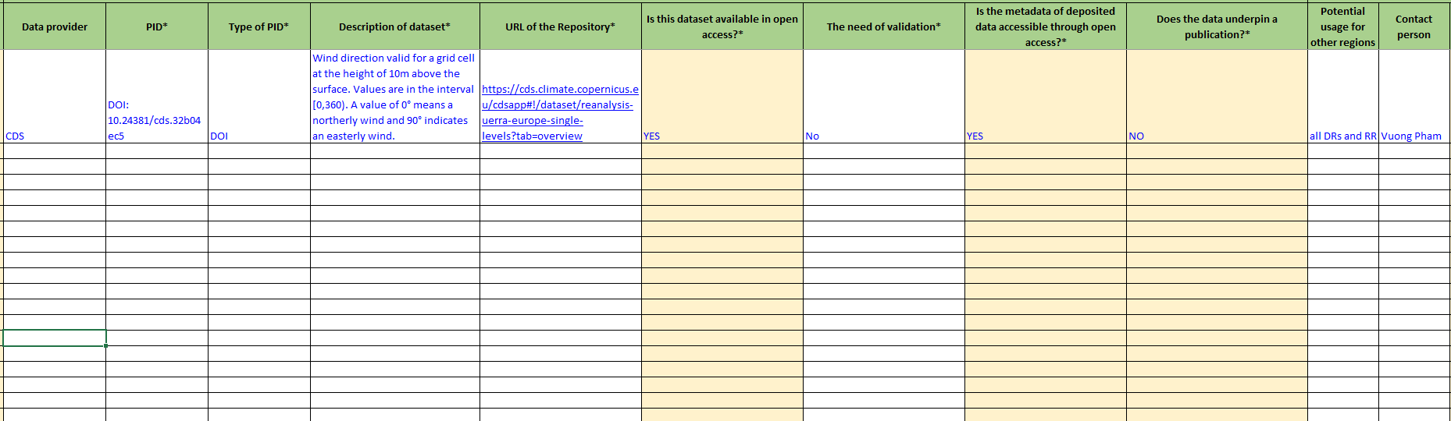
Task 4.2: Risk profiling in DRs
Meta data collection form: any feedback?

Slide 25
Arc-GIS Storymaps
DR4

Slide 26
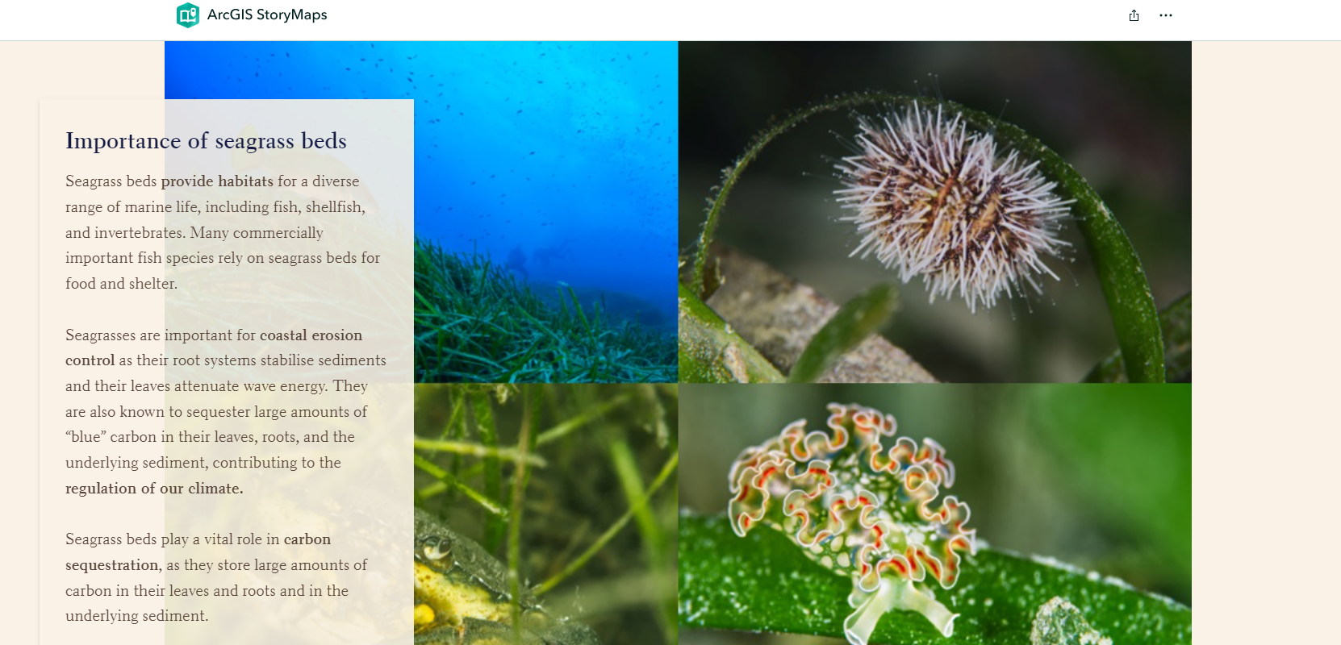
Arc-GIS storymaps
Example: https://storymaps.arcgis.com/stories/aee528a3ef51490bb1d1e392a3669218

Slide 27
Arc-GIS storymaps for DR4
Action | Description | Timeline | Lead | Contributors
Introduction
Case study description
What has been done
Whats next (e.g., Large scale vulnerability analysis)
Model development
Results

Slide 28
WebGIS

Slide 29
Web-GIS
CRORIS - Unos opreme
1. Naziv (*obavezno*)
Hr: Web poslužiteljsko računalo
Eng: Web Server
2. Kratki naziv
Hr: Poslužiteljsko računalo
Eng: Server
3. Opis
Hr: Poslužiteljsko računalo za posluživanje web sadržaja.
Eng: Web server for hosting web content.

Slide 30
WebGIS
Action | Description | Timeline | Lead | Contributors
Technical configuration
Outline of the webgis
Layer selection
WebGIS development
Internal revision and feedback
Publishing

Slide 31
Who
do
what?

Slide 32
Who do what?
Please add the contribution/role in different tasks
Name | Data collection in DR4 | Risk profiling in DR4 | Storymaps | WebGIS | Note
Vuong Pham
Elisa Furlan
Christian Simeoni
Angelica Bianconi
Fabio Favilli
Martina Baučić
Samanta Bačić

Slide 33
Thank you!
Vuong Pham
Vuong.pham@cmcc.it

